Slide 1
EmpowHer
EmpowHER: Empowering Girls for Corporate Excellence Technical Curriculum <Tech>

Slide 2
Agenda Week 1
Angular Installation and Setup
Introduction to Angular
Create a New Angular project
Git and GitHub Basics

Slide 3
Topic Week 1 : Installation And Setup
Pre-requisites
To set up Angular, you'll need to have Node.js and npm (Node Package Manager) installed on your machine.
Download and Install it from the link below.
https://nodejs.org/download/release/v16.20.1/node-v16.20.1-x64.msi
Install Angular CLI
The Angular Command Line Interface (CLI) is a powerful tool that makes it easy to create, build, and test Angular applications.
To install specific version, use below command npm install -g @angular/cli@14.2.10 -g To install latest version, use below command npm install -g @angular/cli
Setup Guide : For more information please click here

Slide 4
Topic Week 1 : Introduction to Angular
Whatis Angular?
Angular is a powerful JavaScript framework for building dynamic, responsive web applications.
Why Choose Angular?
Angular offers many benefits, including a simplified development process, enhanced performance, and robust community support.
Key Features
Some of Angular's key features include a powerful template system, easy data binding, and robust dependency injection.

Slide 5
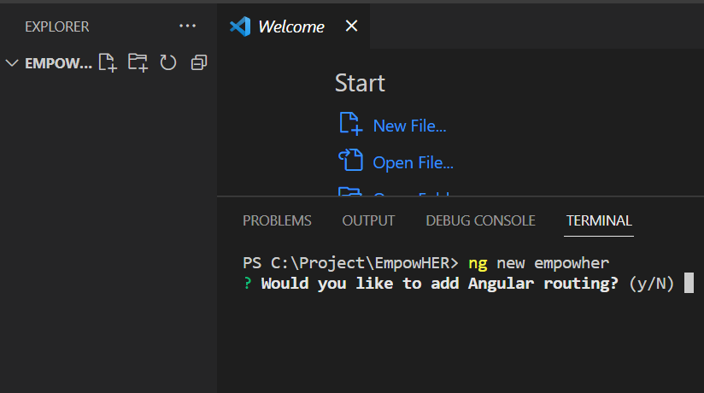
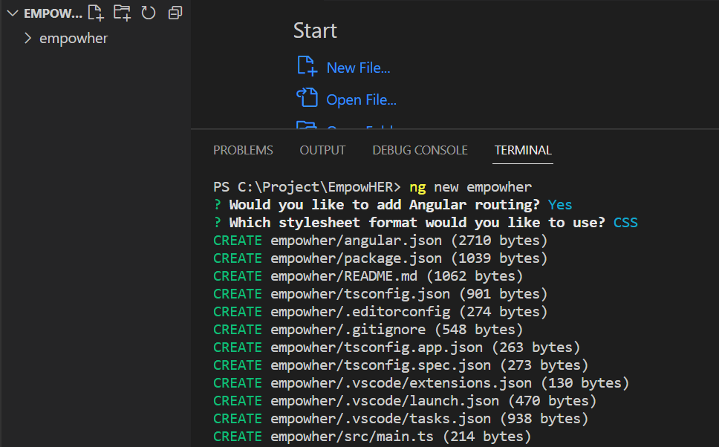
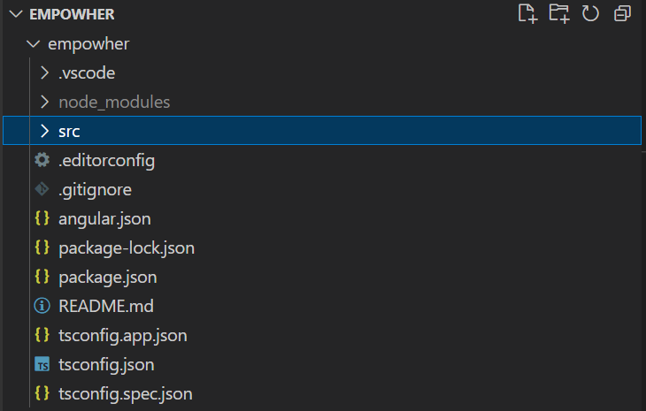
Topic Week 1 : Create a New Angular Project
Step 1 Step 2 Step 3
Type the ng new project-name
In command line.
Select options like routing or CSS
created by ng new.
Explore the generated file structure.

Slide 6
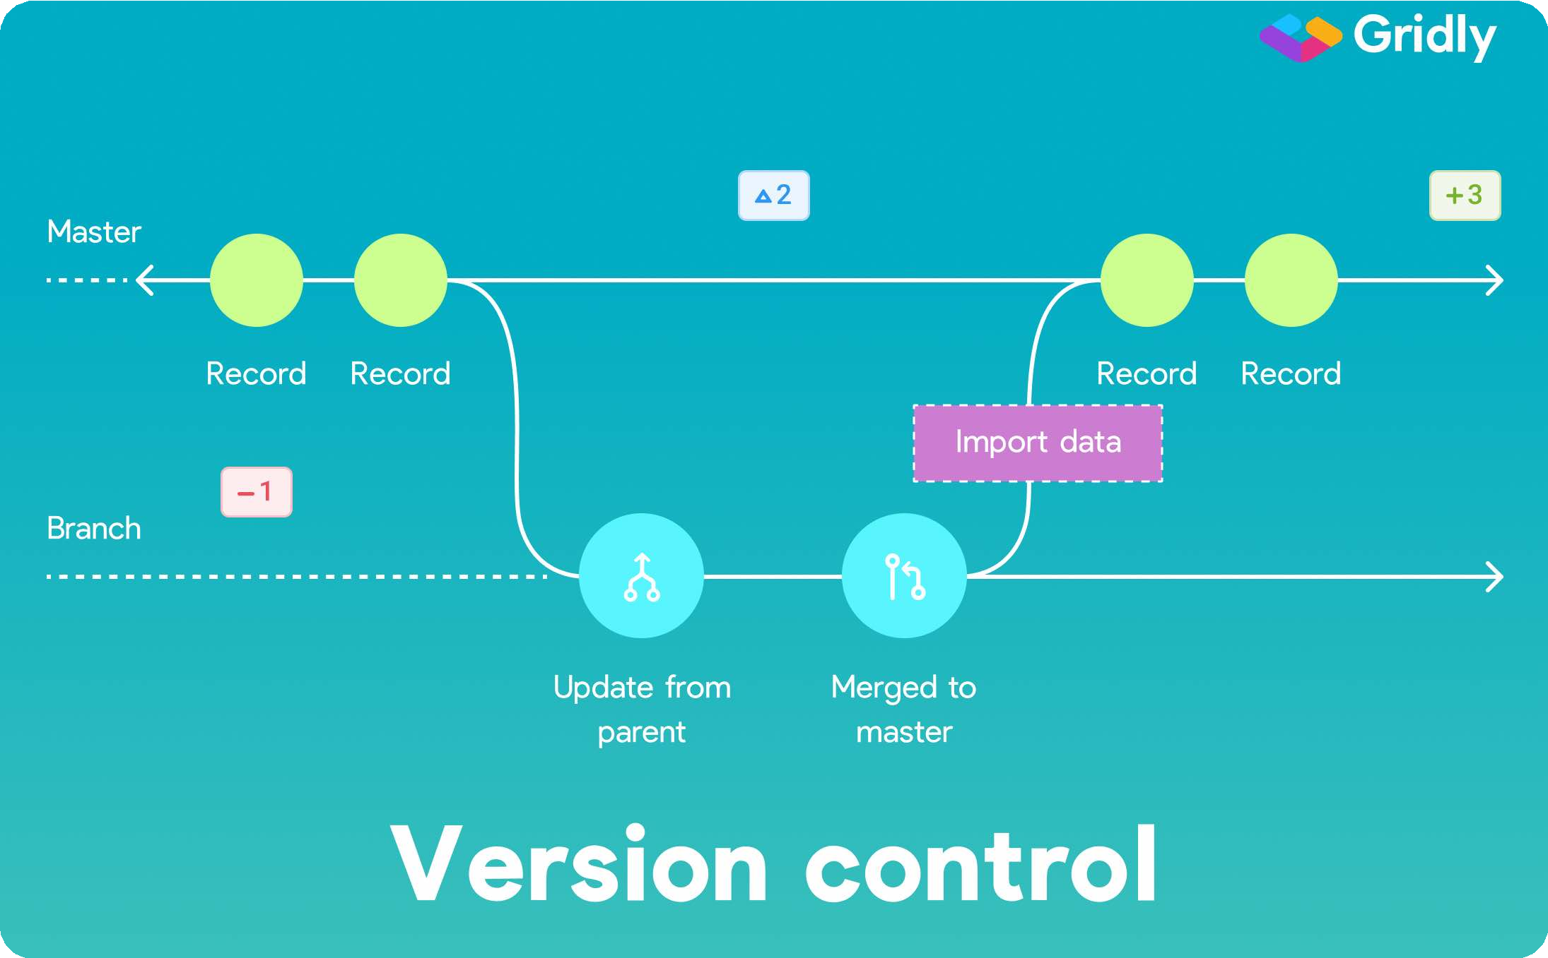

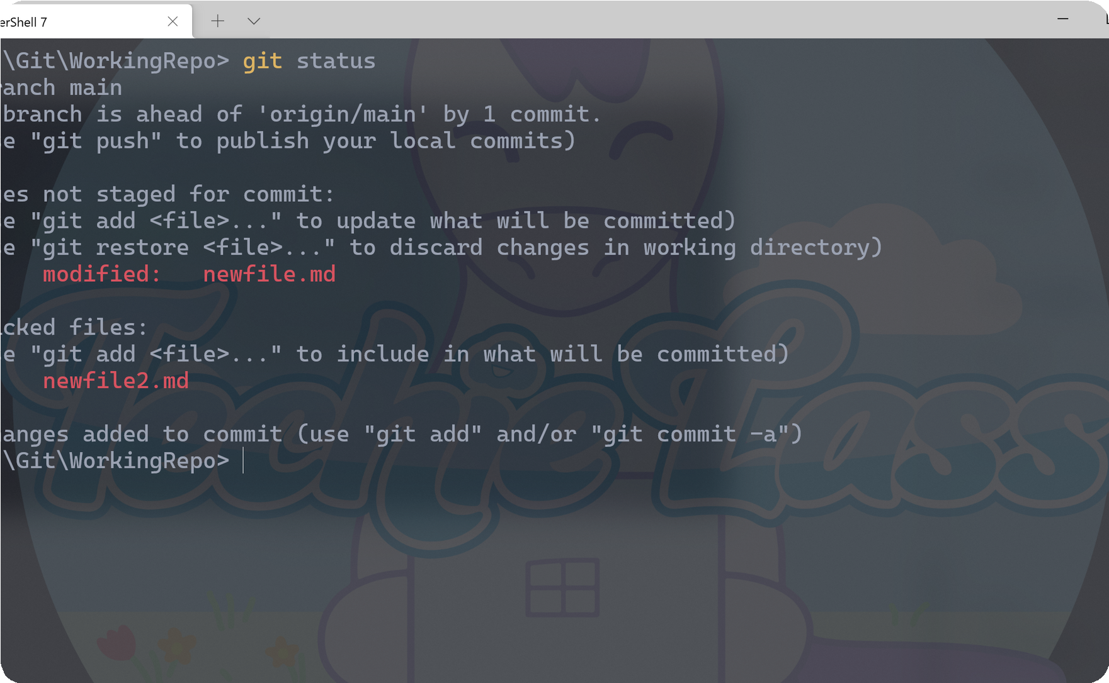
Topic Week 1 : Git and GitHub Basics
Git and Github are essential tools for developers and teams that want to work on projects efficiently and collaboratively.
Version Control
Git provides powerful tools for managing different versions of code, which makes it easier to track changes and manage conflicts.
Collaborating on a Project with Git
Collaborating on projects becomes easier with git. Y ou can collaborate on a project regardless of the location and be sure that everyone has the latest version of the code.
Working with Git Commands
Start working with git and be amazed by its flexibility. T h e s e t u p g u i d e i s g i v e n b e l o w .
Setup Guide : Please click here to open the guide.

Slide 7
Agenda Week 2
HTML
CSS basics
JavaScript
TypeScript

Slide 8
Topic Week 2: HTML
HTML stands for Hyper Text Markup Language
HTML is the standard markup language for creating Web pages
HTML describes the structure of a Web page
HTML consists of a series of elements
HTML elements tell the browser how to display the content
HTML elements label pieces of content such as "this is a heading", "this is a paragraph", "this is a link", etc.

Slide 9
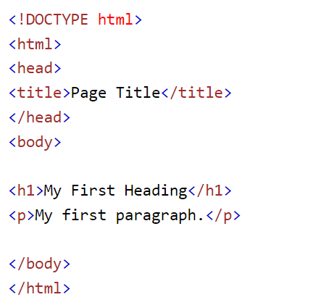
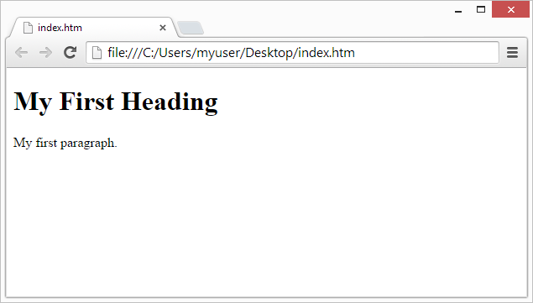
Example
For more information visit - https://www.w3schools.com/html/default.asp

Slide 10
Topic Week 2 : CSS
CSS stands for Cascading Style Sheets
CSS describes how HTML elements are to be displayed on screen, paper, or in other media
CSS saves a lot of work. It can control the layout of multiple web pages all at once
External stylesheets are stored in CSS files
Concepts | Details
Selector | Select which HTML element to style.
Property | Define which aspect of the element to style.
Value | Set the style for the selected element.

Slide 11
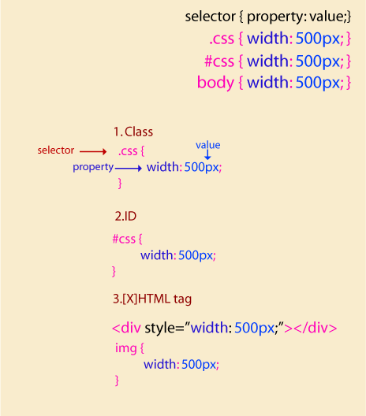
CSS basics
To select elements with a specific class, write a period (.) character, followed by the class name.
To select an element with a specific id, write a hash (#) character, followed by the id of the element.
The element selector selects HTML elements based on the element name such as ‘p’.
The universal selector (*) selects all HTML elements on the page.
For more information visit - https://www.w3schools.com/css/default.asp

Slide 12

Topic Week 2 : J avaScript F undamentals
Data Types
JS has several primitive data types, such as numbers, strings, and booleans. It also has complex data types such as arrays, objects, and functions.
Functions
A function is a set of statements that perform a task. It can be reused throughout the code.
Loops
Loops are used to repeat a set of instructions until a specific condition is met. There are several types of loops in JS.
Events
Events are actions or occurrences that happen in the browser, such as "click" and "load". Use events to trigger JS code.
For more information visit - https://www.w3schools.com/js/default.asp

Slide 13
Topic Week 2 : TypeScript
Why use TypeScript?
TypeScript helps catch errors before they occur by adding static type checking. It also makes code easier to read and maintain.
1
2
3
What is TypeScript?
How TypeScript is used in angular?
TypeScript is a superset of JavaScript that adds optional types, classes, and interfaces to JS.
Browsers can't execute TypeScript directly. Typescript must be "transpiled" into JavaScript.

Slide 14
Agenda Week 3
Tip: Use infographics,
Smart Art,
Images/Screens,
Embed relevant learning videos/case study

Slide 15
Topic Week 3

Slide 16
Agenda Week 4
Tip: Use infographics,
Smart Art,
Images/Screens,
Embed relevant learning videos/case study

Slide 17
Topic Week 4

Slide 18
Agenda Week 5
Tip: Use infographics,
Smart Art,
Images/Screens,
Embed relevant learning videos/case study

Slide 19
Agenda Week 5
Angular Directives and its types
Using inbuilt directives
Creating custom structural and attribute directives
Angular Pipes
Creating custom pipes
Angular Forms

Slide 20
Topic Week 5 - Directives
Directives
Directives are classes with a @directive decorator that add additional behavior to elements in your Angular applications. It helps us to manipulate the DOM. You can change the appearance, behavior, or layout of a DOM element using the Directives. They help you to extend HTML behavior and properties.
Structural
Structural directives can change the DOM layout by adding and removing DOM elements. Eg: ngFor, ngIf, ngSwitch etc.
Attribute
Attribute directives change the appearance or behavior of DOM elements and components. Eg: ngModel, ngClass, ngStyle
Component
A component is a directive-with-a-template; @Component decorator is a @Directive decorator extended with template-oriented features.
Structural Directive
<li *ngFor="let movie of movies"></li>
<movie-detail *ngIf="selectedMovie"></movie-detail>
Attribute Directive
<input [(ngModel)]="movie.name">
Create Directives:
In this section, we will learn how to create directive using Angular CLI command.
To create a directive, use the CLI command-
ng generate directive directive-name
The above command will create the directive inside src/app/directive-name.ts, a corresponding test file .spec.ts and declares the directive class in AppModule.

Slide 21
Topic Week 5 – Attribute Directives
Create Attribute Directives:
Here we will be creating a highlight directive that sets the background color of the host element to yellow.
Run the command: ng generate directive highlight
The @Directive() decorator's configuration property specifies the directive's CSS attribute selector, [appHighlight].
Import ElementRef from @angular/core. ElementRef grants direct access to the host DOM element through its nativeElement property.
Add ElementRef in the directive's constructor() to inject a reference to the host DOM element, the element to which you apply appHighlight.
Add logic to the HighlightDirective class that sets the background to yellow.
To use the HighlightDirective, add a <p> element to the HTML template with the directive as an attribute.
Handling user events:
How to detect when a user mouses into or out of the element and to respond by setting or clearing the highlight color.
Add two event handlers that respond when the mouse enters or leaves, each with the @HostListener() decorator.
Subscribe to events of the DOM element that hosts an attribute directive, the <p> in this case, with the @HostListener() decorator.
Exercise
import { Directive } from '@angular/core’;
@Directive({ selector: '[appHighlight]' })
export class HighlightDirective {
constructor(private el: ElementRef) { this.el.nativeElement.style.backgroundColor = 'yellow’; }
}
Use directive in component template:
<p appHighlight>Highlight me!</p>
import { Directive, ElementRef, HostListener } from '@angular/core’;
@Directive({ selector: '[appHighlight]’ })
export class HighlightDirective {
constructor(private el: ElementRef) {
}
@HostListener('mouseenter') onMouseEnter() { this.highlight('yellow'); }
@HostListener('mouseleave') onMouseLeave() { this.highlight(''); }
private highlight(color: string) { this.el.nativeElement.style.backgroundColor = color;
}}

Slide 22
Topic Week 5 – Structural Directives
Create Structural Directives:
Here we will be creating a highlight directive that sets the background color of the host element to yellow.
Run the command: ng generate directive highlight
The @Directive() decorator's configuration property specifies the directive's CSS attribute selector, [appHighlight].
Import ElementRef from @angular/core. ElementRef grants direct access to the host DOM element through its nativeElement property.
Add ElementRef in the directive's constructor() to inject a reference to the host DOM element, the element to which you apply appHighlight.
Add logic to the HighlightDirective class that sets the background to yellow.
To use the HighlightDirective, add a <p> element to the HTML template with the directive as an attribute.
Handling user events:
How to detect when a user mouses into or out of the element and to respond by setting or clearing the highlight color.
Add two event handlers that respond when the mouse enters or leaves, each with the @HostListener() decorator.
Subscribe to events of the DOM element that hosts an attribute directive, the <p> in this case, with the @HostListener() decorator.
Exercise
import { Directive } from '@angular/core’;
@Directive({ selector: '[appHighlight]' })
export class HighlightDirective {
constructor(private el: ElementRef) { this.el.nativeElement.style.backgroundColor = 'yellow’; }
}
Use directive in component template:
<p appHighlight>Highlight me!</p>
import { Directive, ElementRef, HostListener } from '@angular/core’;
@Directive({ selector: '[appHighlight]’ })
export class HighlightDirective {
constructor(private el: ElementRef) {
}
@HostListener('mouseenter') onMouseEnter() { this.highlight('yellow'); }
@HostListener('mouseleave') onMouseLeave() { this.highlight(''); }
private highlight(color: string) { this.el.nativeElement.style.backgroundColor = color;
}}

Slide 23
Topic Week 5 - Pipes
Pure Pipe
<div>{{ date | localedate: "fr" }}</div>
Attribute Directive
<ul>
<li *ngFor="let n of numbers | sorted">{{ n }}</li>
</ul>
Create Pipes:
In this section, we will learn how to create pipe using Angular CLI command.
To create a pipe, use the CLI command-
ng generate pipe pipe-name
The above command will create the pipe inside src/app/pipe-name.ts, a corresponding test file .spec.ts and declares the pipe class in AppModule.
Pipes
Pipes are to transform strings, currency amounts, dates, and other data for display. Pipes are simple functions to use in template expressions to accept an input value and return a transformed value.
Impure Pipes
Impure pipes are pipes that can detect changes within objects. Changes within objects include things like changing array entries or object properties.
Pure Pipes
A pure pipe is a pipe that is run when a pure change is detected. A pure change is a change to a primitive JavaScript input value like strings, numbers, booleans, symbols or an object reference change.

Slide 24
Topic Week 5 – Pure Pipes & Impure Pipes
Create Pure Pipes:
Here we will be creating a localedate pipe that transform that date format.
Run the command: ng generate pipe localedate
To mark a class as a pipe and supply configuration metadata, apply the @Pipe decorator to the class.
All pipes implement the PipeTransform interface, which specifies that the pipe class must have the transform method. In it, we get the value parameter and then we return a new value derived from it.
We put the pipe name after the variable we want to format in our component template.
Pipes can take arguments. And we can get them from the args parameter in the transform method.
import { Pipe, PipeTransform } from "@angular/core";
@Pipe({
name: "localedate",
})
export class LocaledatePipe implements PipeTransform {
transform(value: Date, ...args: any[]): string {
return value.toLocaleDateString();
}
}
import { Pipe, PipeTransform } from "@angular/core"; @Pipe({
name: "sorted",
pure: false,
})
export class SortedPipe implements PipeTransform {
transform(numbers: number[], ...args: unknown[]): number[] {
return numbers.sort((a, b) => a - b);
}}

Slide 25
Agenda Week 6
Angular Forms
Reactive Forms & Validations
Strictly typed Reactive Forms
Template Driven Form

Slide 26
Topic Week 6

Slide 27
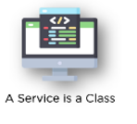

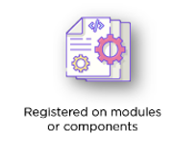

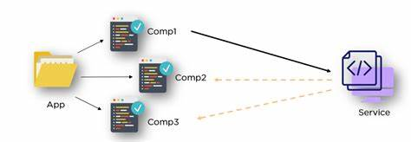
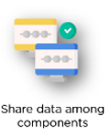

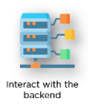
Agenda Week 7 - Angular Services
A service is typically a class with a narrow, well-defined purpose. A service can be any value, function, or feature that an application needs. It should do something specific and do it well.
Why We should use Service ?

Slide 28
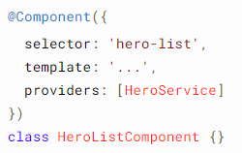
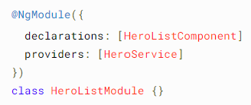
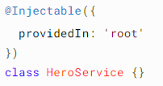

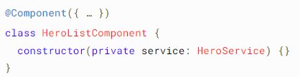
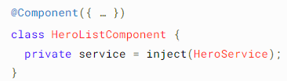
Agenda Week 7 - Angular DI
Dependency injection (DI) provides components a way to access services and other resources.
Providing dependency
OR OR
Injecting a dependency
OR

Slide 29
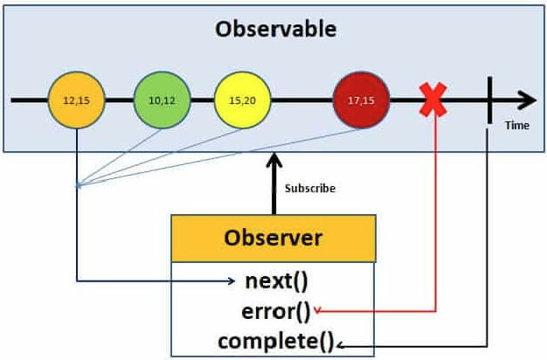
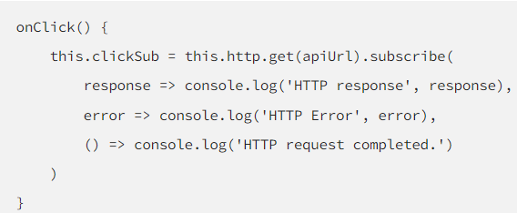

Agenda Week 7 - Angular Observable and Http
Observable is like a data source. It is from Rxjs.
Implemented by following an observable pattern. where we have an observable and an observer and in between, we have a timeline where we can have multiple events, or data packages, emitted by the observable.
HttpClient service is available as an injectable class, with methods to perform HTTP requests. Each request method has multiple signatures, and the return type varies based on the signature that is called
Subscribing to an Observable Un-Subscribing to an Observable

Slide 30
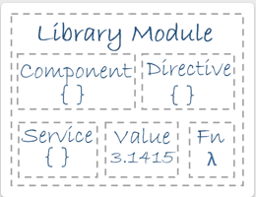

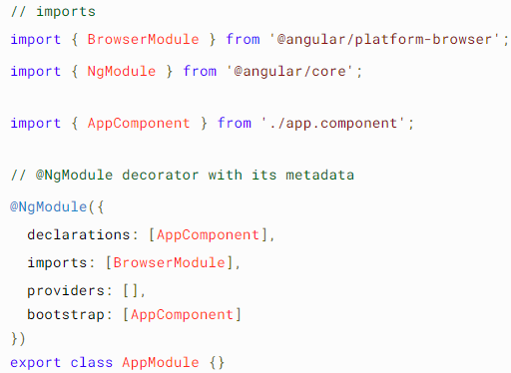
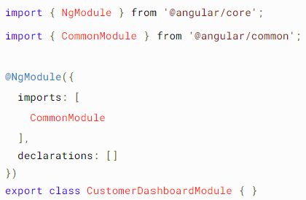
Agenda Week 8 – Angular Modules
Angular has its own modularity system called NgModules. NgModules are containers for components, service providers, and other code files whose scope is defined.
Every Angular application has at least one Generate Module Using Angular CLI NgModule class, app.module.ts

Slide 31

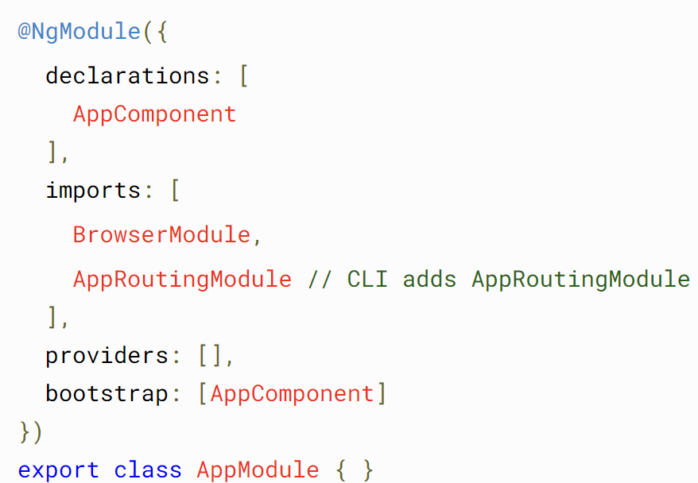
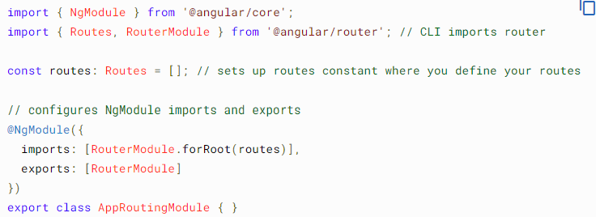
Agenda Week 8 – Angular Routing
To handle the navigation from one view to the next, you use the Angular Router. The Router enables navigation by interpreting a browser URL as an instruction to change the view.
Generate Routings with Angular CLI
Changes to the App Module CLI Generated Routing module

Slide 32
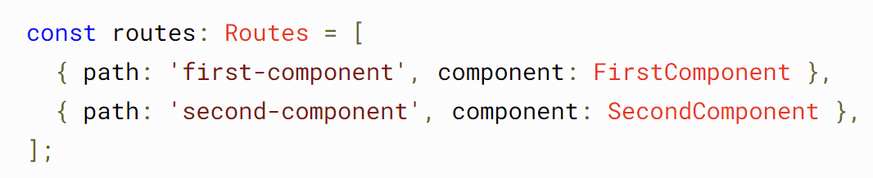


Agenda Week 8 – Angular Routing
Configuring the Routes
Setting up redirections
Configuring the Wild Cards or Display 404 page.
Lazy Loading

Slide 33

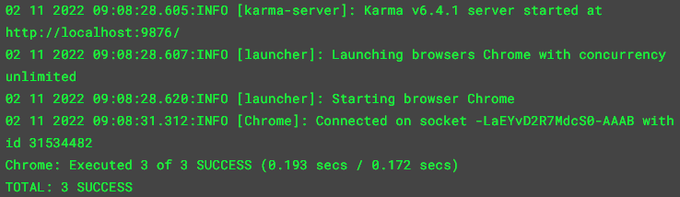
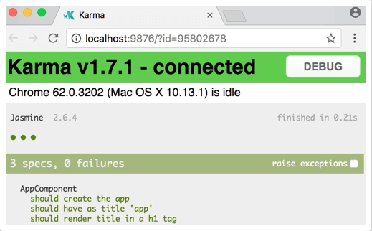

Agenda Week 9 – Angular Unit Testing.
Testing your Angular application helps you check that your application is working as you expect.
You can Test Components, Services, Directives, Pipes, Routes, etc.
Setting Up Tests Project you create with the CLI is immediately ready to test. Just run the CLI command
Console output looks the below Browser output looks the below
Find the Code Coverage with CLI Command

Slide 34
Topic Week 9

Slide 35
Agenda Week 10
Tip: Use infographics,
Smart Art,
Images/Screens,
Embed relevant learning videos/case study

Slide 36
Topic Week 10

Slide 37
Appendix
Add Links or permissible Images as needed

